Slide 1
Bank Transaction Volume Forecasting – Anticipate Customer Transaction Patterns
By Gopalakrishnan Kumar, MTech IIT-Bombay,
Freelance Data Science Consultant
LinkedIn: Profile Link : https://www.linkedin.com/in/gopalakrishnankumar-a73301110/
Github:https://www.github.com/Gopalakrishnan-Kumar/
Kaggle URL- https://www.kaggle.com/gopalkk2

Slide 2
Google Colab URL
https://colab.research.google.com/drive/1HpX3u5X2MZfY-6MdFkst_377cDt-Mk5l?usp=sharing

Slide 3
Introduction
Banks handle millions of transactions daily across multiple channels such as Online Banking, In-Branch Transactions, and ATM Withdrawals. With the rapid rise of digital banking, customer preferences are shifting significantly. By analyzing and forecasting transaction patterns, banks can:
Optimize resources (e.g., staffing, ATM cash refills, server capacity).
Improve customer experience by reducing wait times and ensuring smooth operations.
Plan strategically for investments in digital vs. physical infrastructure.
This report uses data visualization and forecasting models to anticipate trends in transaction volumes.

Slide 4
Dataset Description
For this study, we used monthly transaction volumes over a 12-month period (Jan–Dec 2022). The dataset includes the following columns:
Date: Monthly transaction records.
Online: Number of digital/online transactions.
In-Branch: Transactions done physically at branches.
ATM: Transactions conducted via ATMs.

Slide 5
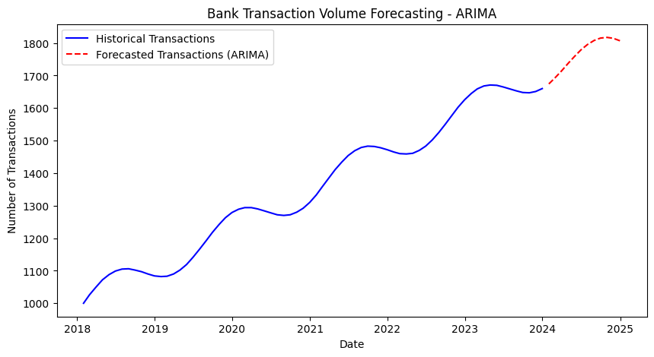
Data Visualization

Slide 6
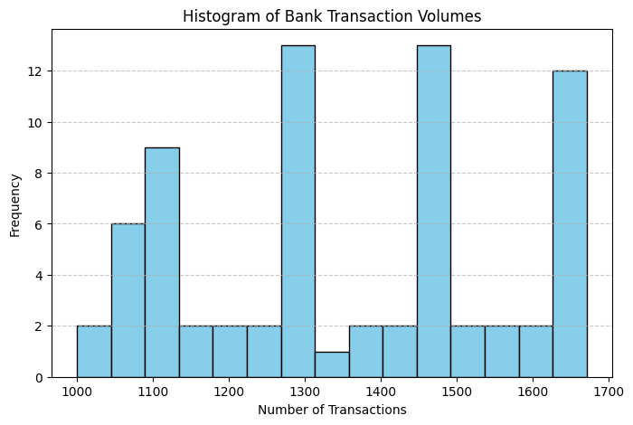
Data Visualization

Slide 7
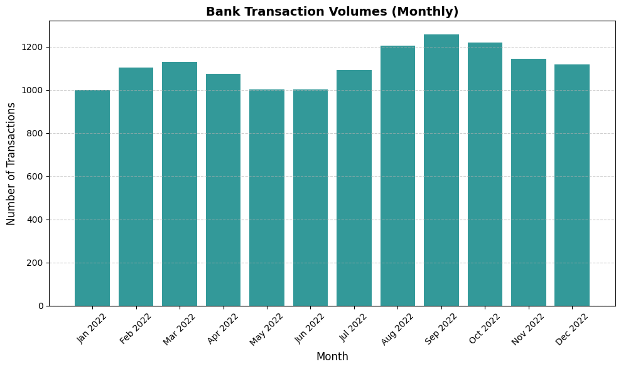
Data Visualization

Slide 8
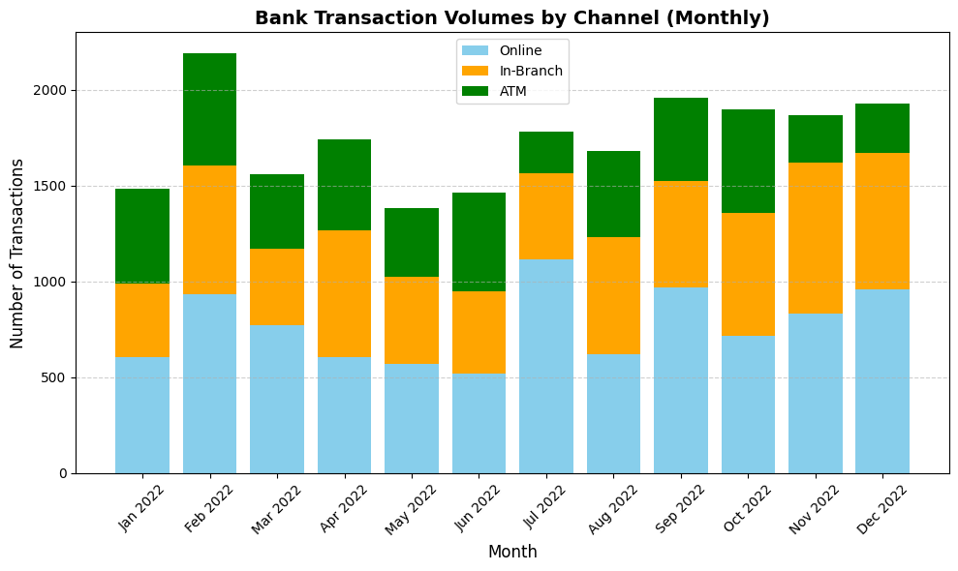
Data Visualization

Slide 9
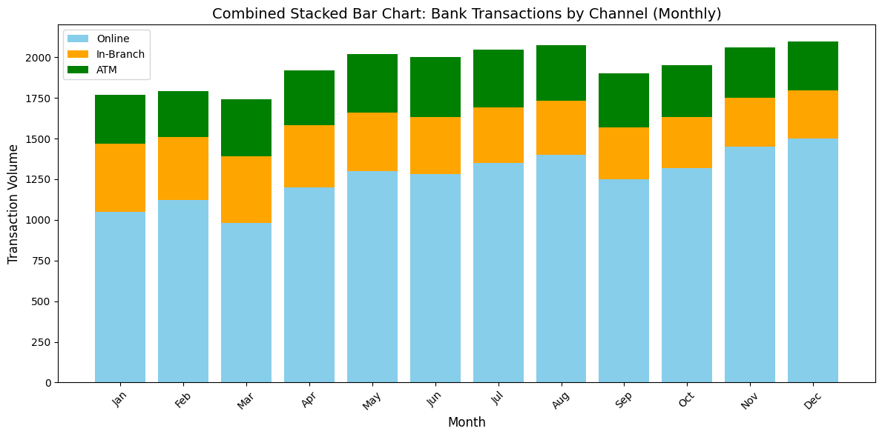
Data Visualization

Slide 10
Forecasting Approach
To forecast transaction volumes, we recommend:
Time-Series Models: ARIMA, Prophet, or LSTM for capturing monthly patterns.
Scenario Forecasting:
Digital adoption accelerates → Online share increases further.
Pandemic or disruptions → Higher ATM/Branch usage temporarily.

Slide 11
Business Implications
Digital Investments: Rising online usage suggests more investments in mobile apps,
cybersecurity, and servers.
Branch Optimization: Declining branch usage means possible branch consolidation
or repurposing.
ATM Maintenance: Stable ATM usage highlights need for predictive cash refilling
and maintenance scheduling.
Customer Segmentation: Different customer segments (youth vs senior citizens) prefer
different channels — banks can design personalized services.

Slide 12
Conclusion
Online transactions dominate and will continue to grow.
Branch transactions are steady but reducing — banks must balance physical and digital operations.
ATM usage is stable but contributes less to the total share.
Forecasting transaction volumes helps banks make data-driven decisions, allocate resources efficiently, and stay competitive in the digital era.
This report can be expanded with:
Multi-year stacked bar charts (to observe longer trends).
Forecast plots (predicting next 12–24 months).
Correlation analysis with external factors (holidays, salary cycles, promotions)

